Slide 1

Project Overview
Aetna Insurances | Sutherland Global Services | Presenter Name: Vignesh. K

Slide 2



Slide 3
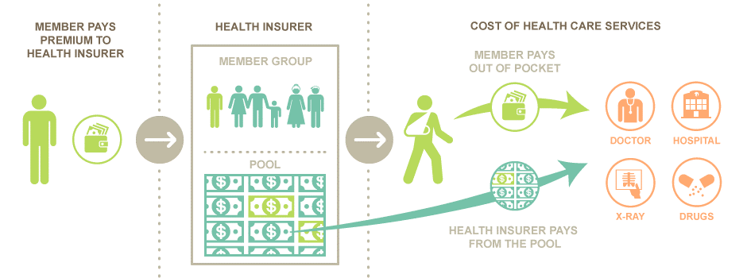

Slide 4

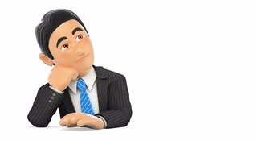
What is Aetna?
Aetna’s company name is inspired from Mt. Etna, which was the most active volcano in Europe.
Aetna Inc., incorporated on December 20, 1982, is a diversified healthcare benefits company. The Company operates through three segments: Health care, Group Insurance and Large Case Pensions. Aetna is a member of the Fortune 500. Aetna revenue as of 2017 is $ 60.53 Billion.

Slide 5

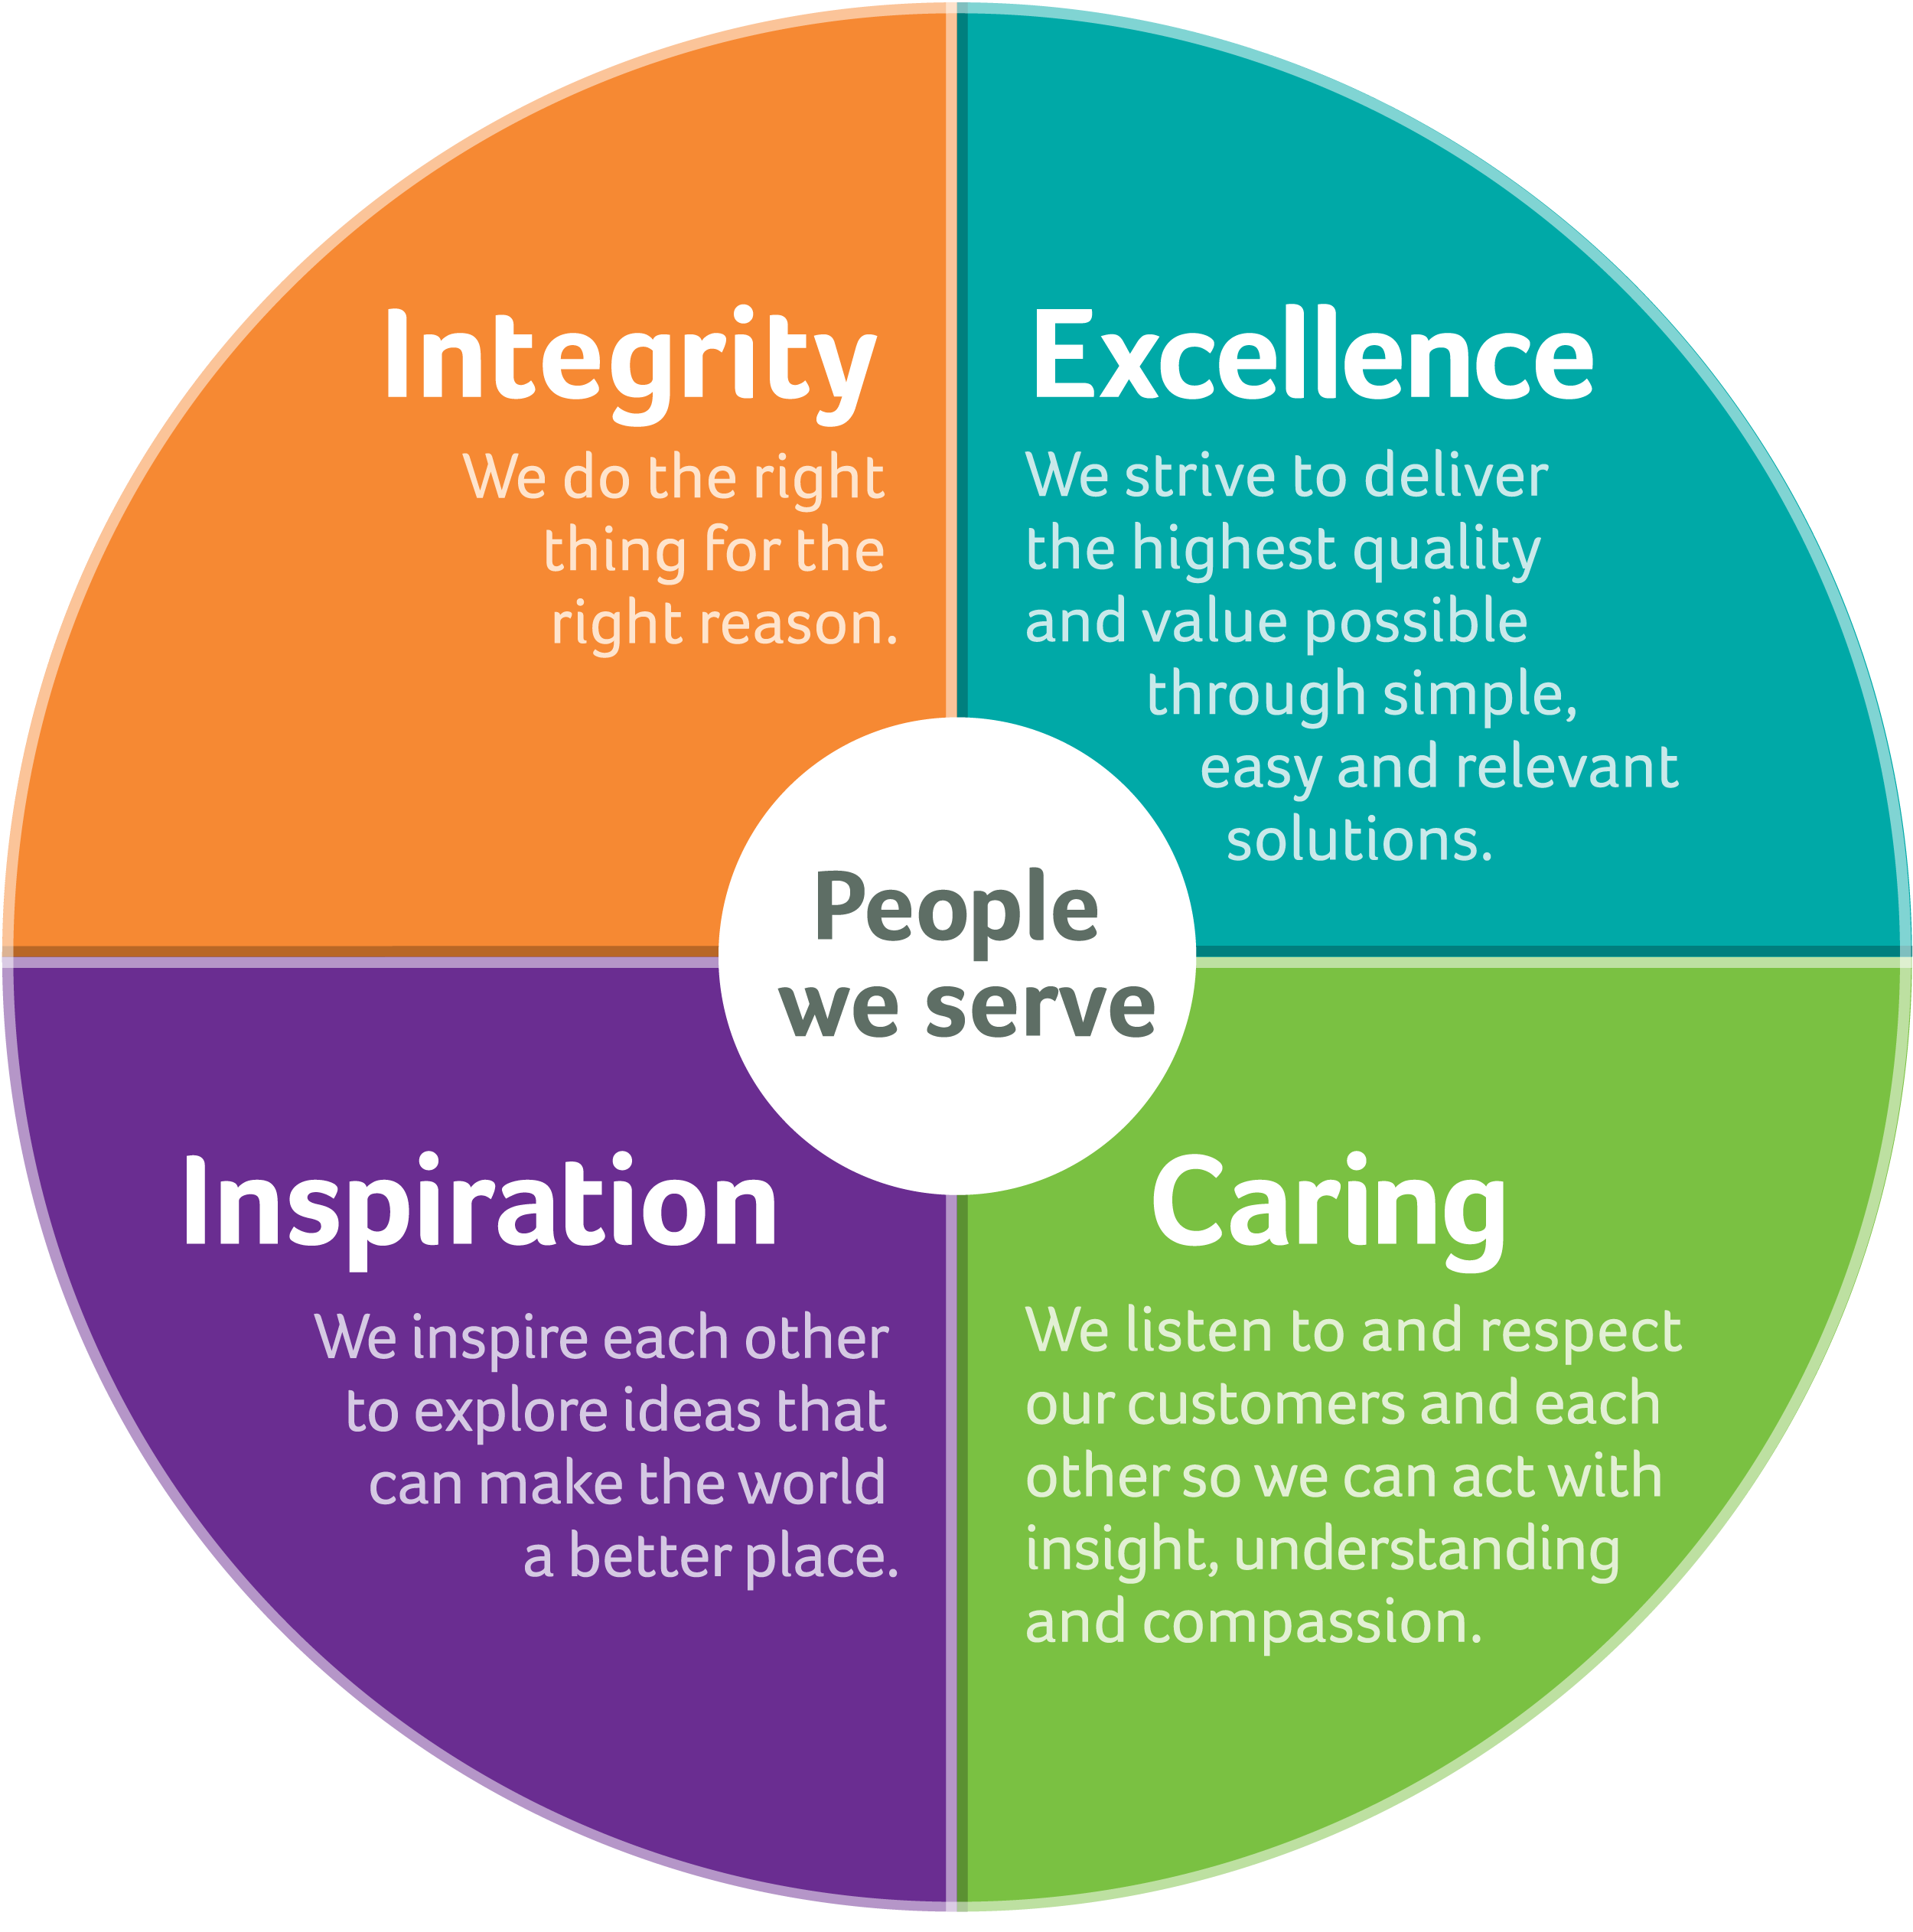


Slide 6
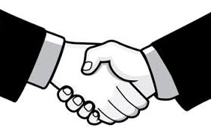
AetAetna & Sutherland
Join Hands on Oct 2014

Slide 7
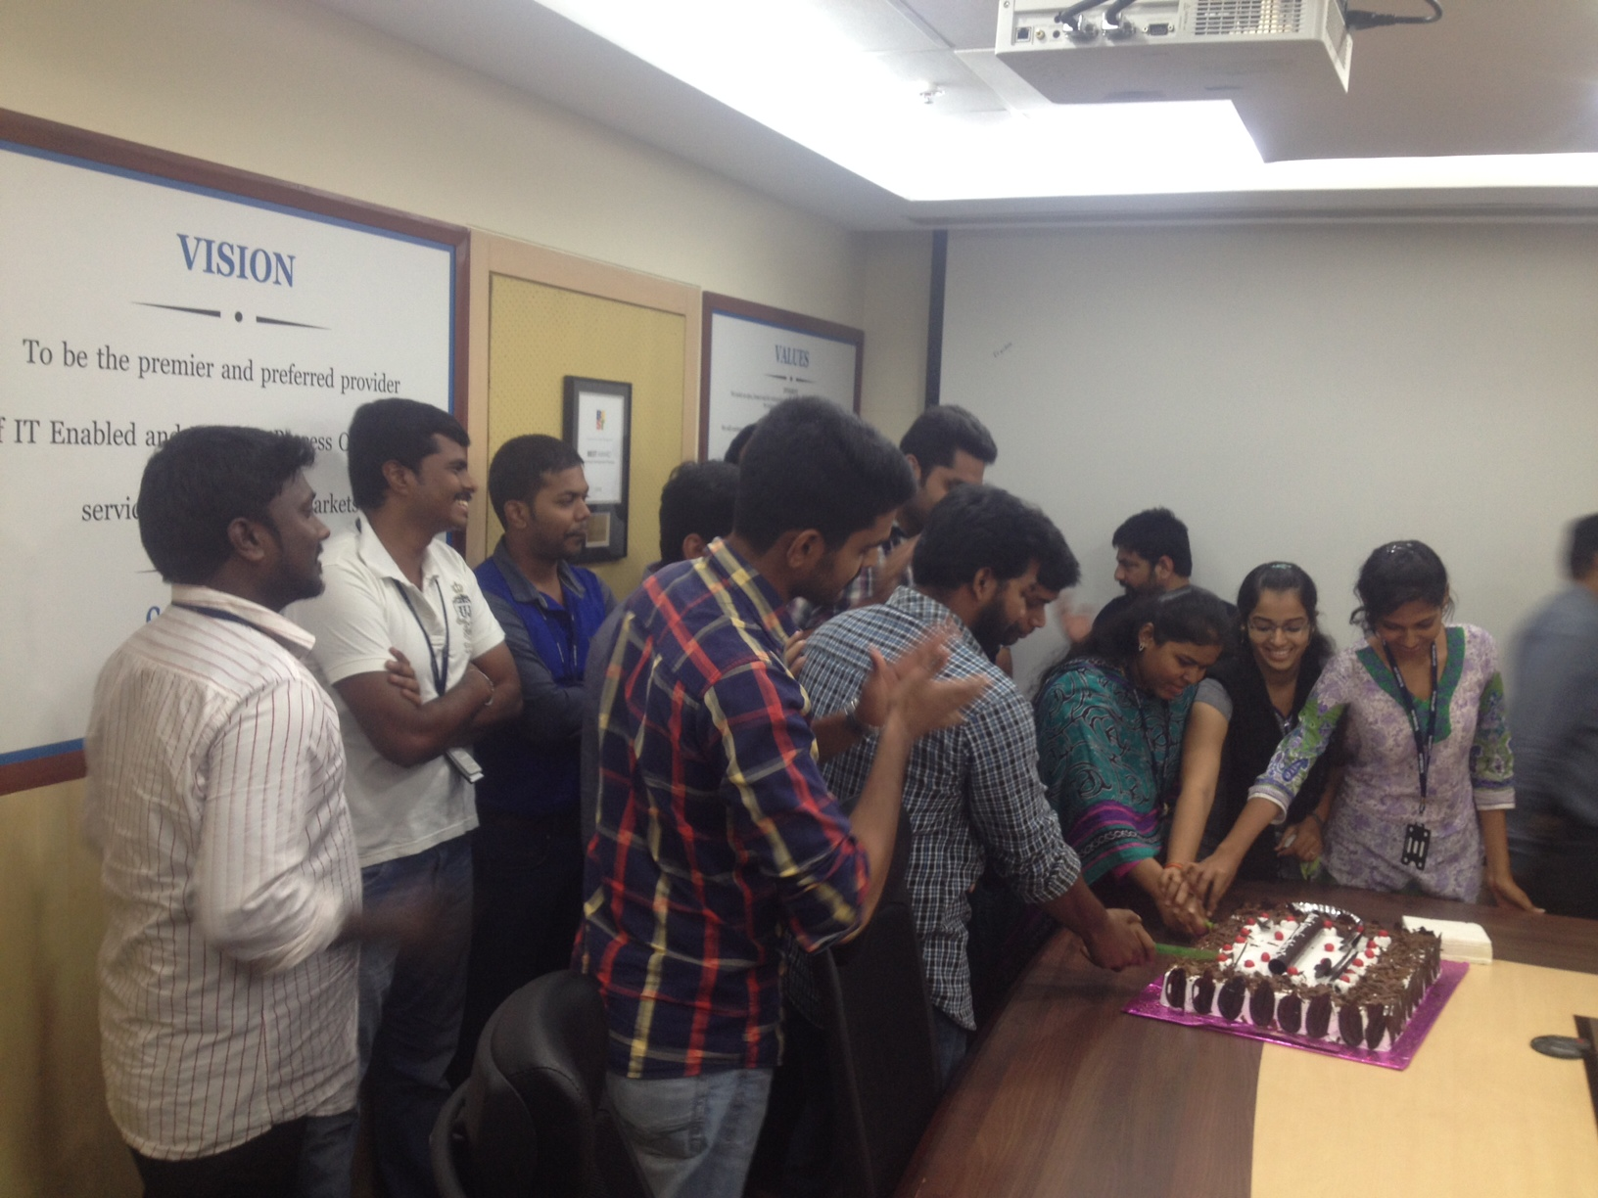
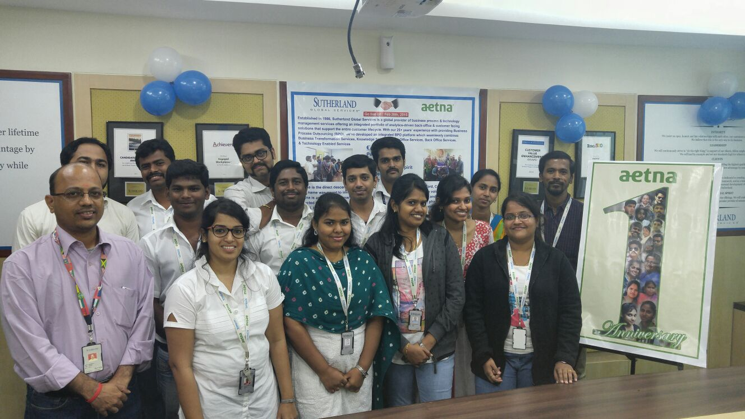
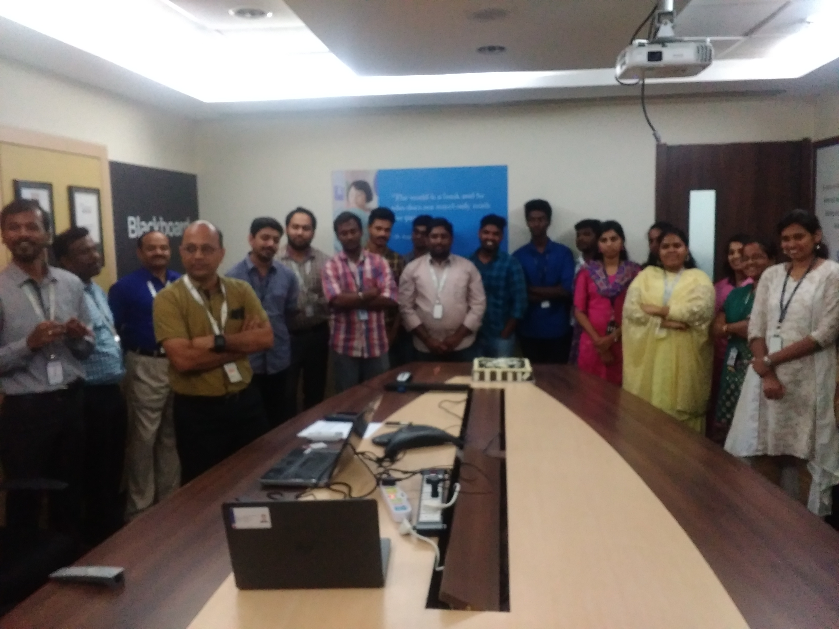
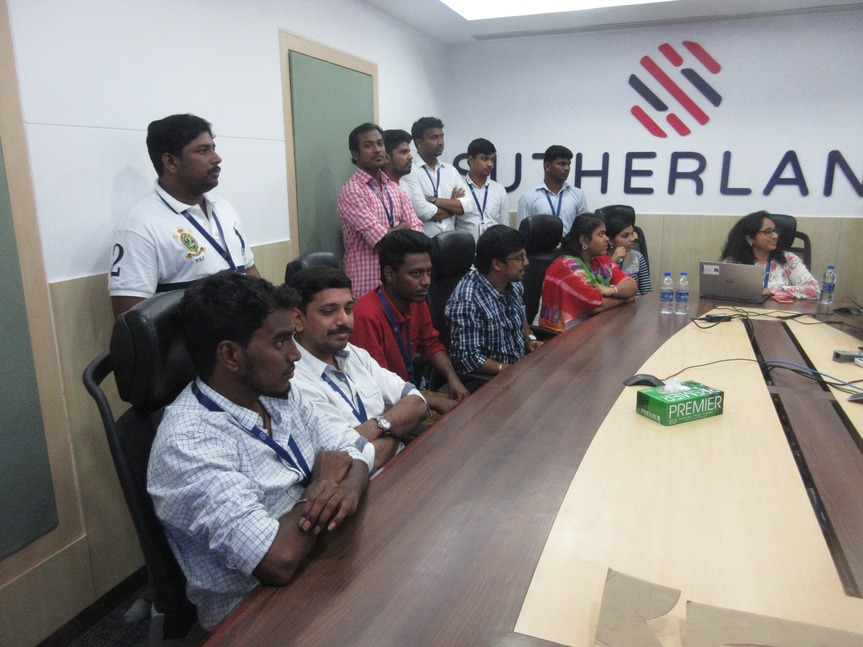
Go Live on Feb 20th
2015
1st Anniversary Feb 20th
2016
2nd Anniversary Feb 20th
2017
3rd Anniversary Feb 20th
2018

Slide 8
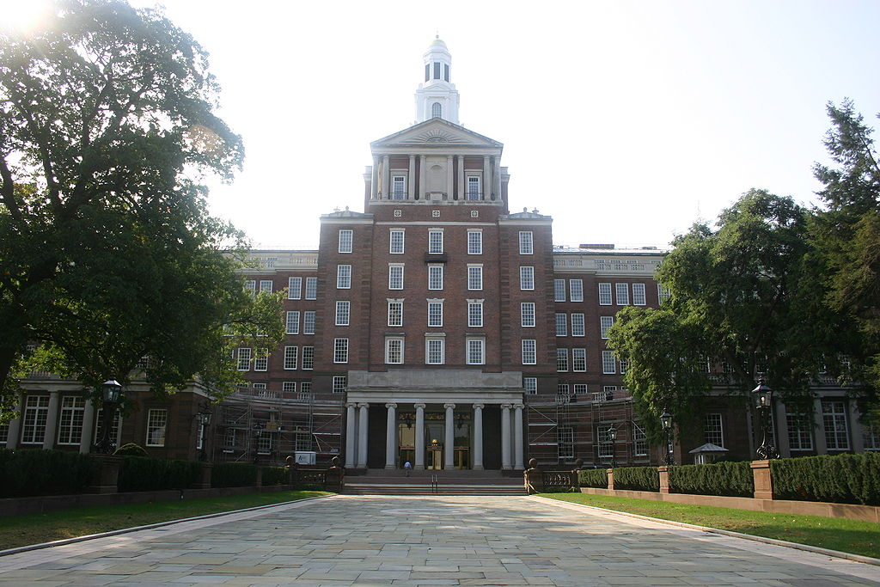
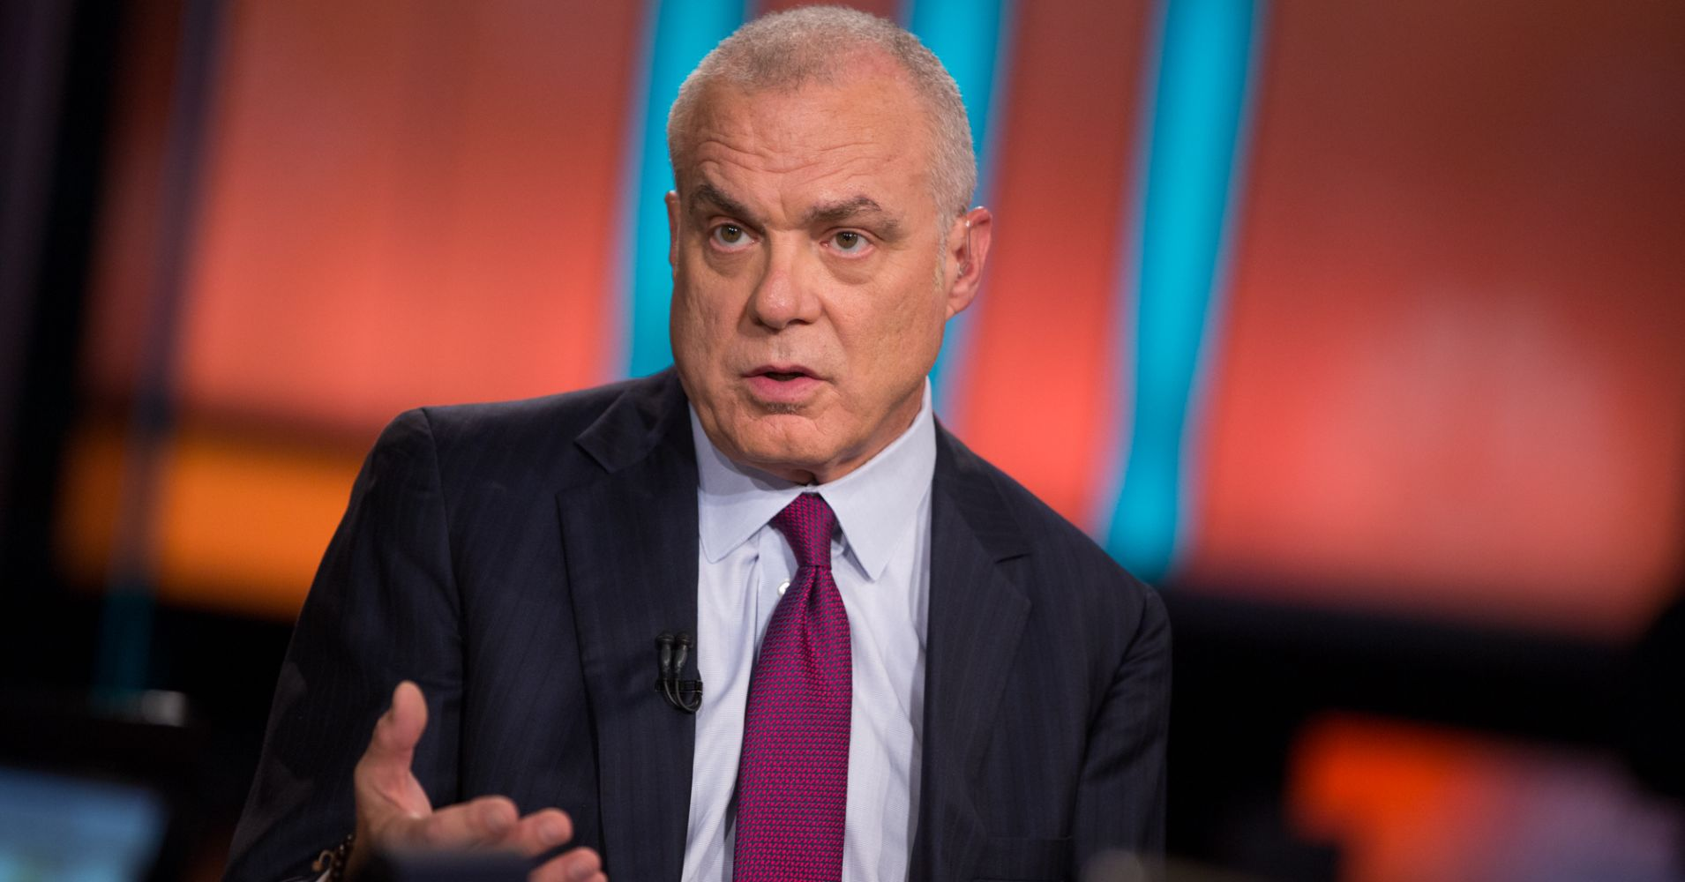
Hartford Aetna Headquarters
Aetna is a member of the Fortune 500
Mark Bertolini CEO Of Aetna

Slide 9


What are the Services Sutherland provides to Aetna?
Cash Application, Billing & Claims R&R

Slide 10
Contact Details
Process Details
LOB | Description | Team Head Count | Aetna Managers | Operations Handling | Governance Call
Cash Application | Cash Application is to process premiums, allocate the same to the respective customer accounts. | 11 FTE’S | Hill, Andrew | Check & Wire payments | Every month 2nd Wednesday
Billing | Fee received for services render. | 3 FTE’S | Quiroga, Mario A | Service Fee Billing | Nil
Claims R & R | Notification to an insurance company that payment of an amount is due under the term of the policy. | 5 FTE’S | Jacter, Lianna H; Leonardo, Al | Accounting & Operations | Every month 2nd Thursday

Slide 11
Hierarchy Level
Mukesh Nanik Masukhani
VP – Account Manager
Soosai Antony Neowin Missier
(Director)
Vijaya Kumar
(Associate Manager)
Service Fee Billing
Cash Application
Claims R &R

Slide 12
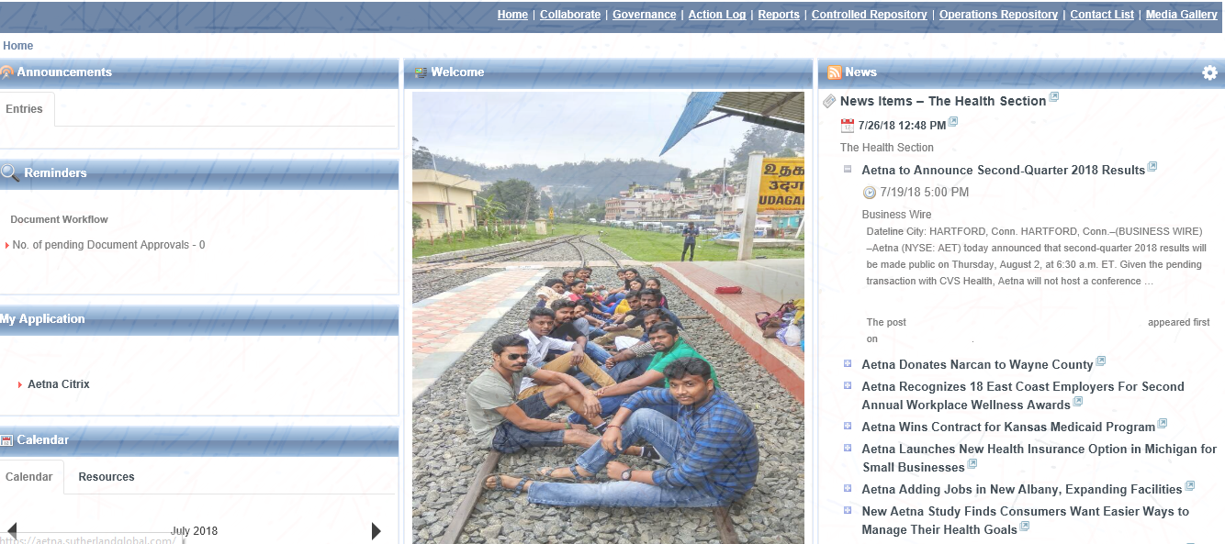

What are all thing is updated in Aetna portal?
Governance
Contact List
Action Log
Operations Repository
Sutherland Portal home Page
Report
Controlled Repository

Slide 13


Award Category
Team Outing
News letter
You make a Differences Award
Alchemist Award
New SPARK Award
Numero UNO Award - Team
Fun Friday
Mater Mind Award
R & R
SPOT Award
Team Dinner

Slide 14
Things to Know

Slide 15

Do’s
Lock your computer before you walk away.
Check your Sutherland outlook mailbox often.
Wear your ID card inside the office premises.
Shutdown your system (SGS & Citrix) properly once your shift over.
Share the shift mobile number to your parents for emergency contact.
Attendances correction need to sent before 22nd of every month.
Don’ts
Don’t wear round neck/V-neck tees.
Don’t wear sandals & clogs.
Don’t wear collared t-shirt on Monday.
Don’t bring your mobile inside the production floor.
Don’t bring any snacks/food inside the production floor.

Slide 16

Any Questions and Feedback

Slide 17
Thanks

