Slide 1

WORK FROM HOME

Slide 2

The History of Remote Work:
The concept of work from home, or telecommuting, started to take shape in the early 1970s.
This shift is primarily attributed to Jack Niles, a Nasa engineer, who conducted pioneering research on the feasibility and benefits of telecommuting.
Late 20th century
1990s to 2000s :
Personal computers, fax machines and internet further facilitated WFH.
Some companies began experimenting with telecommuting programs, Though it was not widespread.
COVID-19 pandemic (2020-present)
2020: The C19 forced a sudden and massive shift to WFH.
Many businesses had to adopt quickly to remote operations, accelerating the adoption of digital tools and changing work culture.

Slide 3

WHY WORK FROM HOME IS BEST AND ITS BENEFITS:
For Employees:
Improved work life balance
Reduced commuting stress
Increased productivity
Cost savings
Comfort and personalization.
For Employers:
Access to a global talent pool
Cost savings
Increased productivity
Business continuity.
Social benefits:
Reduced traffic and pollution
Decreased energy consumption.

Slide 4



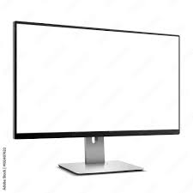
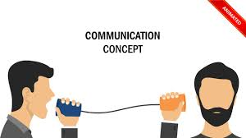

Also, it has its drawbacks:
Isolation and Loneliness
Distractions
Communication challenges
Reduced team cohesion
Health concerns.

Slide 5


Thank you

