Slide 1
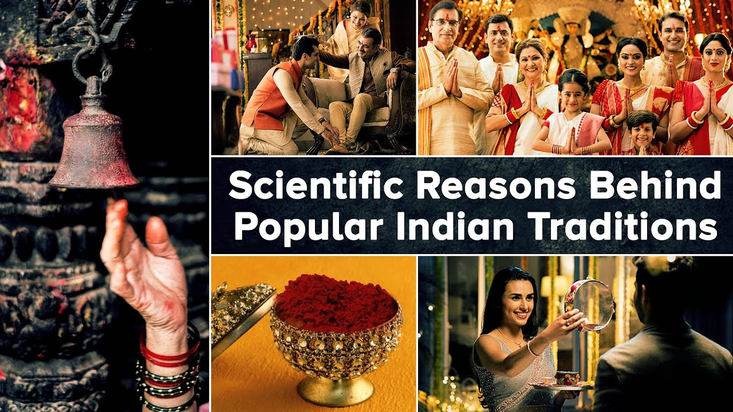

Slide 2
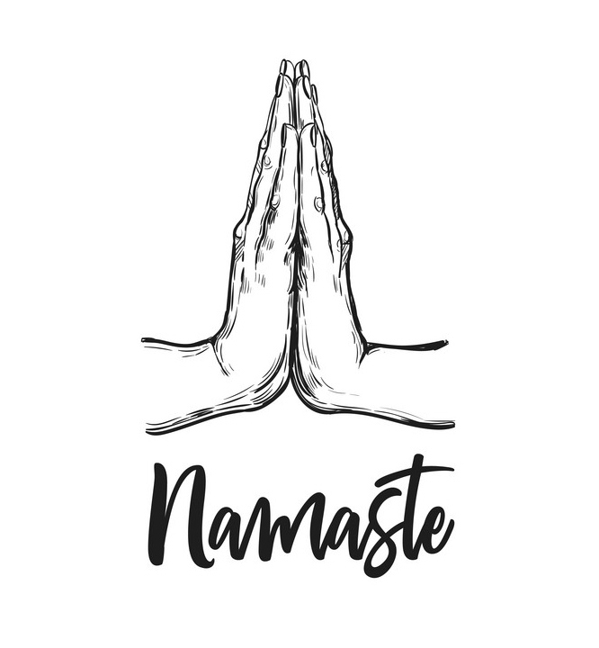
Joining Both Palms Together To Greet
In Hindu culture, people greet each other by joining their palms – termed as “Namaskar.” The general reason behind this tradition is that greeting by joining both the palms means respect. However, scientifically speaking, joining both hands ensures joining the tips of all the fingers together; which are denoted to the pressure points of eyes, ears, and mind

Slide 3
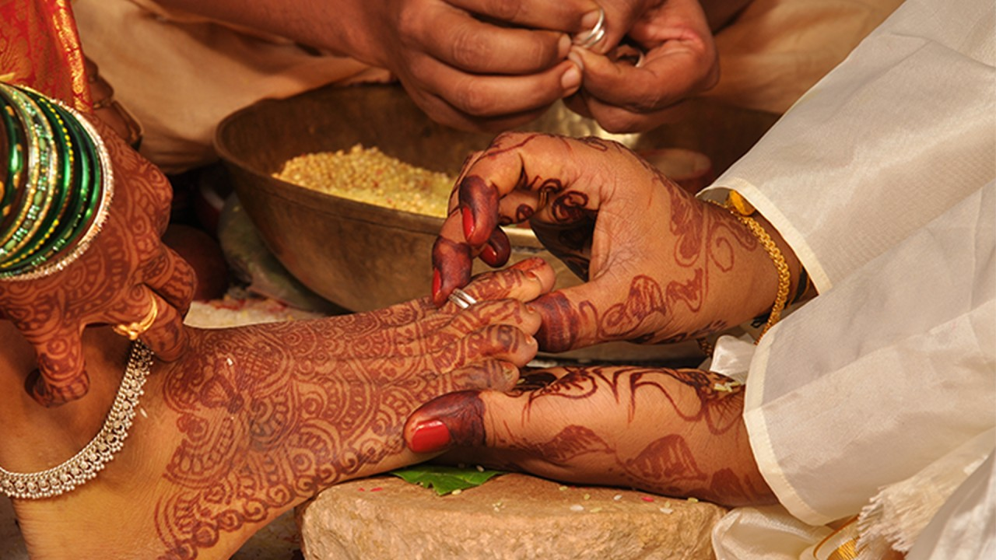
Why Do Indian Women Wear Toe Ring
Wearing toe rings is not just the significance of married women but there is science behind it. Normally toe rings are worn on the second toe. A particular nerve from the second toe connects the uterus and passes to heart. Wearing toe ring on this finger strengthens the uterus.

Slide 4
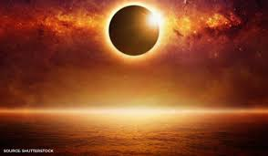
Not going out during solar eclipse
The only logical explanation to this scientific occurrence is that the ultraviolet rays from the sun are the strongest during this time and are extremely harmful for the body. Thus, should be avoided.
Myth
Getting blind
Indians don’t prefer to cook or eat

Slide 5
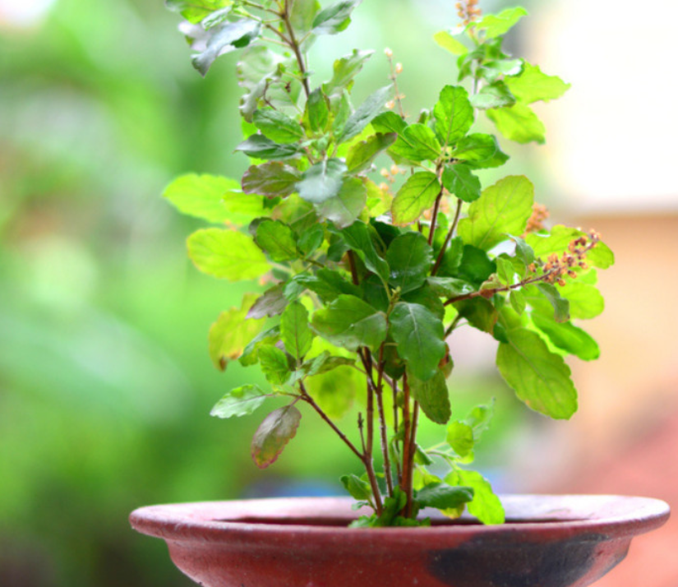
Why Do We Worship Tulsi Plant
Keeping Tulsi plant at home prevents insects and mosquitoes from entering the house. It is said that snakes do not dare to go near a Tulsi plant. Maybe that is why ancient people would grow lots of Tulsi near their houses.

Slide 6
CONCLUSION
By examining popular myths from various culture and comparing them with scientific explanations, we can explore the evolution of human understanding over time. By looking into more myths and how science explains things, we can get a better grip on the world around us.

Slide 7


