Slide 1


Employee Connect Forum
May 2024
Call date – 15th June 2024
// © 2024 Sutherland Global Services, Inc. All Rights Reserved.

Slide 2
Team Updates
2 // © 2024 Sutherland Global Services, Inc. All Rights Reserved.

Slide 3




Team Updates :
Operational Metric’s :
Cash application team started working on additional activities.
GL team received access to asset run module and did their 1st asset addition report run.
New work under GL is expected.
SLA’s and KPI’s have met in all the three LOB’s.
Process Update:
Team has successfully completed May month-end closure for all three LOB.
Team Performance
Help Items / Training :
May’24
Team SADH is 98.74 % for May 2024.
Team Shrinkage is 6.02% for May 2024.
Team AHT Utilization is 65% for May 24
1 attrition for AETNA.
None
3
// © 2024 Sutherland Global Services, Inc. All Rights Reserved.

Slide 4
Aetna - SLA & KPI’s
Note :
Billing : We have received volume in 7 KPI’s & 1 SLA out of 9 Deliverables.
Cash Allocation : We have received volume in 26 KPI’s & 1 SLA out of 29 Deliverables.
Claims R & R : We have received volume in 18 KPI’s & 1 SLA out of 21 Deliverables.
4
// © 2024 Sutherland Global Services, Inc. All Rights Reserved.

Slide 5

Claims R & R – Volume Trend Analysis
Claims R & R - Process updates:
In May 2024 we had received 381 requests, which is 40% lesser compared to May 2023.
Claims Volume is significantly reduced due to migration from Aetna to CVS.
As per the last governance call, we may receive new work under Claims R&R.
We had received overall volume of 6,497 in 2023 and it is 2,051 for 2024( Jan - May).
5
// © 2024 Sutherland Global Services, Inc. All Rights Reserved.

Slide 6
SFB Billing – Volume Trend Analysis:
SFB Billing – Process updates:
As KEY SFB Billing customers are migrating into the EBS billing tool, we are receiving less volume compared to previous years.
We can see the volume fluctuation in each weeks of May’24 and in the 4th week we have received volume of 3610 due to billing month end.
Total volume received in May 2024 is 9799, which is higher compared to 7865 in May 2023.
The overall volume for previous year 2023 it was 2,95,929 and it is 97,103 in 2024(Jan – May).
6
// © 2024 Sutherland Global Services, Inc. All Rights Reserved.

Slide 7
Cash Allocation – Volume Trend Analysis:
Cash Allocation -- Process updates:
The volume received in May 2024 is 7706 which is slightly higher compared to 6990 received in May 2023.
Overall volume received in previous year was 92,711 . It is 38,623 in current year till May 2024.
Cash application Team as started working on the additional activities like Premium refund JE and research requests from May 2024. And we are yet to receive one more activity related to bank statements.
We have received 758 Traditional Checks & 2,827 Wires in the month of May and Values for Traditional checks is $33.01 million & for wires $525.58 million.
7
// © 2024 Sutherland Global Services, Inc. All Rights Reserved.

Slide 8
Aetna – UNID payments till 06/10/2024:

Slide 9
Aetna – UNID payments till 06/10/2024:
Major Contribution: AGB WIRES & JPMC WIRE
$34,686.08 GB Collects JPMC WIRE - 644602203 (AGB) Waiting for the support.
$12,359.09 WENESTIM INC JPMC WIRE - 644602203 (AGB) Binder Payment.
$1,590.42 Real Time Payment - CADENCE COALITION LIMITED LIABILITY COMP JPMC WIRE - 644602203 (AGB) Waiting for support.
$0.01 Digital Therapeu JPMC WIRE – 5540194 Waiting for the support
$838.11 ALICFNBC 5540194 JPMC WIRE – 5540194 Waiting for the support
$1472.59 INDIUM CORPORATION OF AME JPMC CHECK-LB21673 Waiting for the support
// © 2024 Sutherland Global Services, Inc. All Rights Reserved.

Slide 10
GL Recon Update: May 2024
225 recons are completed on time.
Asset addition work is being performed by GL team now.
© 2024 Sutherland Global Services, Inc. All Rights Reserved.

Slide 11
Aetna Insurance – Attendance May 2024
Notes:
Team Shrinkage is 6.02% for period May 2024.
Keerthana, Ram, Balaji, Lavanya and Swathy S had availed1 SL and 1 PL each.
Debasish has taken 4 days PL.
11
// © 2024 Sutherland Global Services, Inc. All Rights Reserved.

Slide 12
Aetna Prohance SADH – Update: May 2024
Notes:
Team % ---- 98.74%
12
// © 2024 Sutherland Global Services, Inc. All Rights Reserved.

Slide 13
Aetna AHT Utilization – Update: May(till 05/31/2024)
Notes:
Team AHT Utilization is 65% till May 31, 2024.
Total FTE allocated : 14
Team utilized: 65%
Team not utilized: 35%
13
// © 2024 Sutherland Global Services, Inc. All Rights Reserved.

Slide 14

May’2024 Birthday Luminary
14
// © 2024 Sutherland Global Services, Inc. All Rights Reserved.

Slide 15
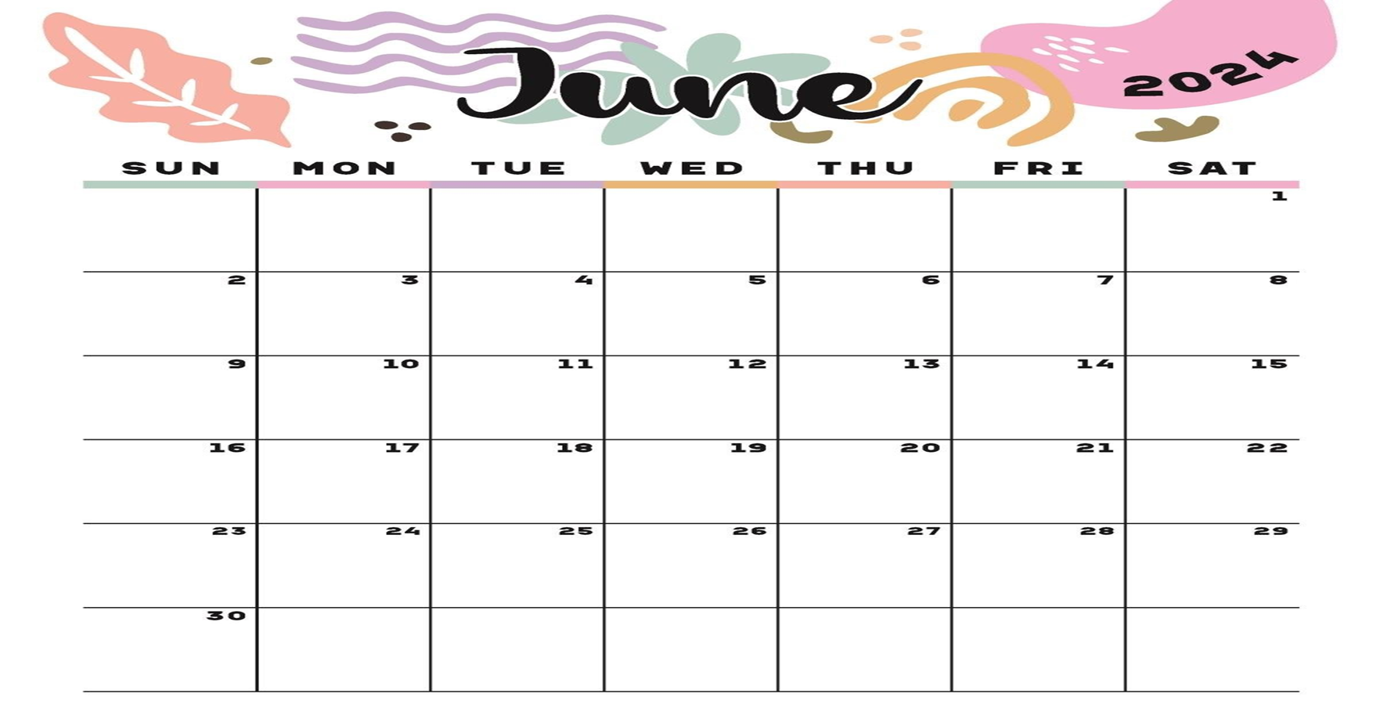


HRC Calendar – June 24 Activities
15
// © 2024 Sutherland Global Services, Inc. All Rights Reserved.

Slide 16
Thank you

