Slide 1

Team Performance Overview
Nov 01, 2021
1
// © 2020 Sutherland Global Services, Inc. All Rights Reserved.

Slide 2





Automation Updates
Operational Metric’s
Cash Allocation :
BOT Updates:
Post couple of follow up’s to Gowri and Aetna RPA team, they wanted to check the SGS RPA team availability for tomorrow’s call @ 10.00 AM EST
SLA’s & KPI’s of Cash allocation, Billing & Claims R & R are met from Oct 25 to Oct 29, 2021.
General Update:
Claims team received RUMBA Target clean up request from Jeff on Oct 01, 2021, which consists of 543 Targets.
On Oct 18, 2021 – We have received Medicare Advantage check issue activity from Jeff, which consists of 362 items.
Team Performance
Help Items
None
Team SADH is 98.67% from period Oct 01 to Oct 22, 2021.
Team Shrinkage is 7.59% from period Oct 01 to Oct 22, 2021.
2
// © 2020 Sutherland Global Services, Inc. All Rights Reserved.

Slide 3
Aetna – SLA / KPI’s :
Note :
Billing : We received volume in 6 KPI’s & 1 SLA out of 6 Deliverables.
Cash Allocation : We received volume in 28 KPI’s & 1 SLA out of 31 Deliverables.
Claims R & R : We received volume in 12 KPI’s & 1 SLA out of 14 Deliverables.
3
// © 2020 Sutherland Global Services, Inc. All Rights Reserved.

Slide 4
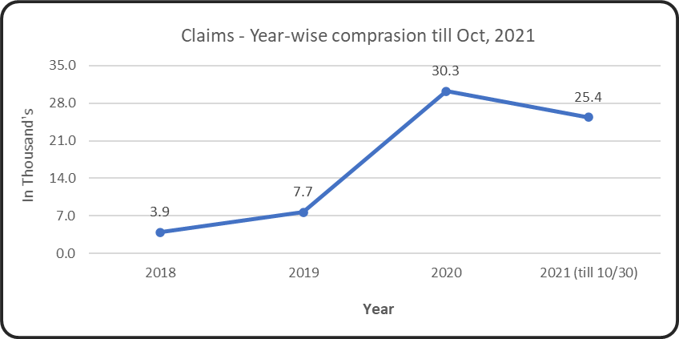
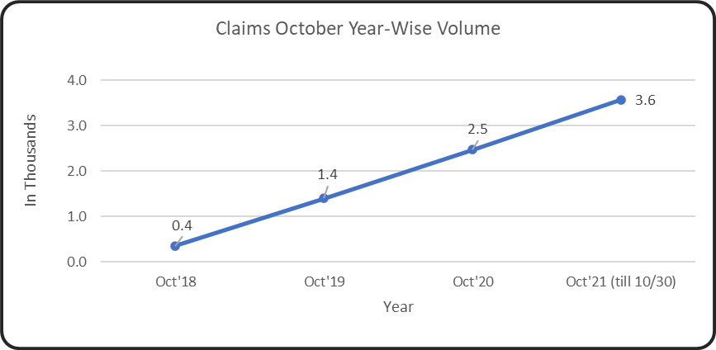
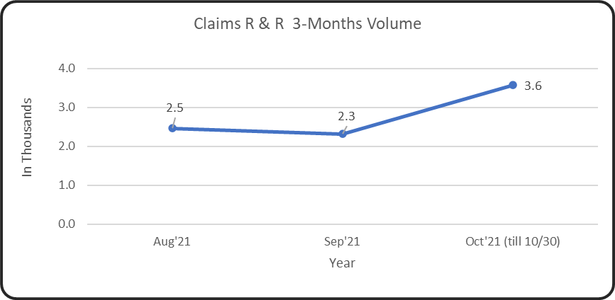
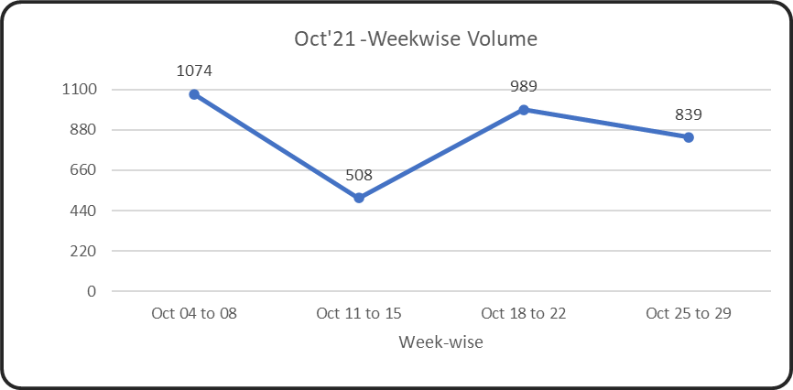
Aetna – Claims R & R – Volume Trend Analysis:
Note :
We have received RUMBA Target clean up request from Jeff on Oct 01, 2021, which consists of 543 Targets. Team have completed those clean up request on Oct 05,2021. (532 Workable, 11 Non-Workable).
On Oct 18, 2021 – We have received Medicare Advantage check issue activity from Jeff, which consists of 362 DCU’s.
4
// © 2020 Sutherland Global Services, Inc. All Rights Reserved.

Slide 5
Aetna – KPI Tracker Claims from Oct 25 to Oct 29, 2021 :
5
// © 2020 Sutherland Global Services, Inc. All Rights Reserved.

Slide 6
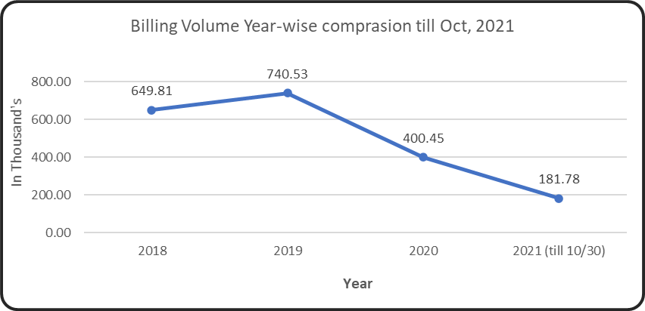
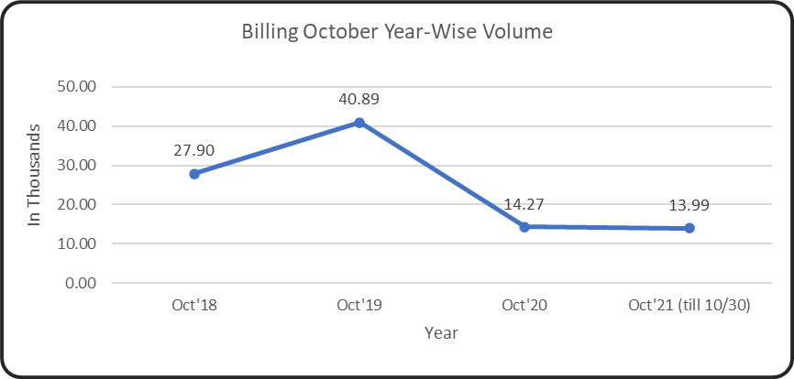
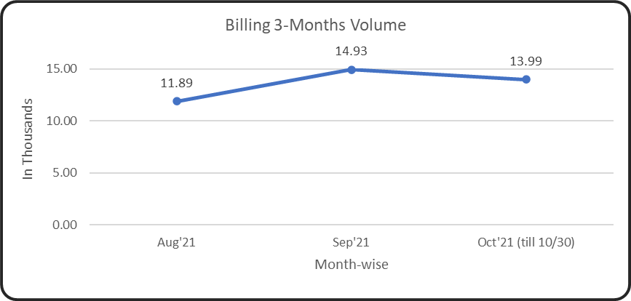
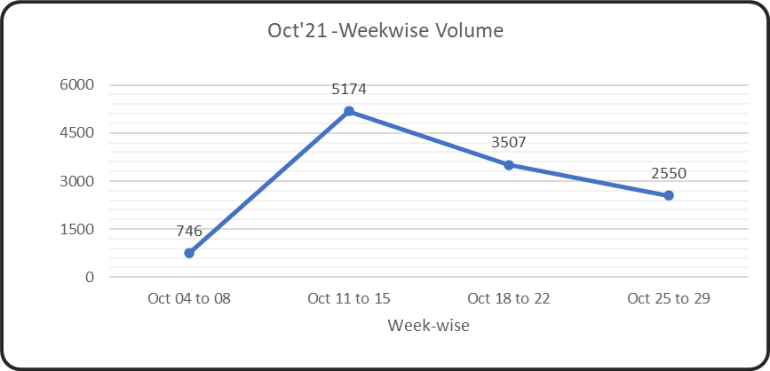
Aetna –SFB Billing – Volume Trend Analysis:
Note :
We have received updated plans from customer on the second week of October’2021.
6
// © 2020 Sutherland Global Services, Inc. All Rights Reserved.

Slide 7
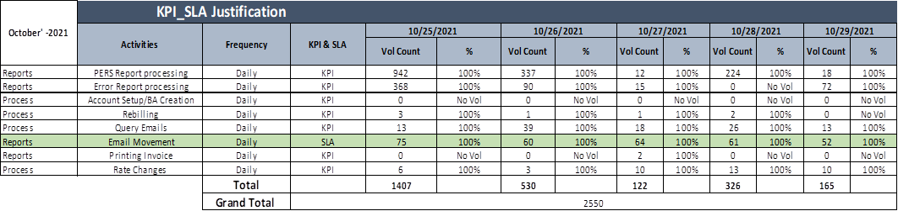
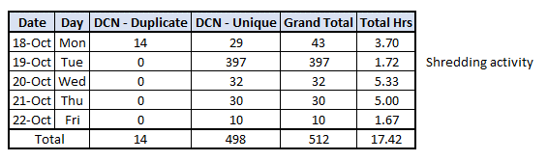
Aetna – KPI Tracker Billing from Oct 25 to Oct 29, 2021 :
Returned Check process :
Need to update
Note :
Processed 14 – Duplicate – DCN’s
Processed 498 – Unique – DCN’s.
7
// © 2020 Sutherland Global Services, Inc. All Rights Reserved.

Slide 8
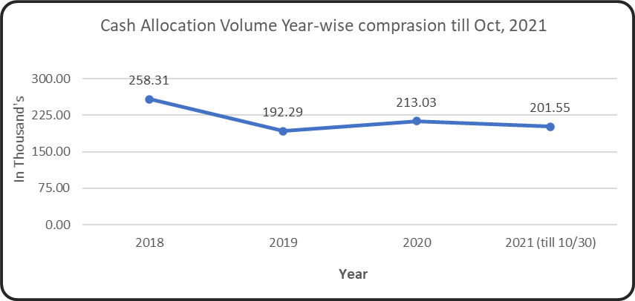
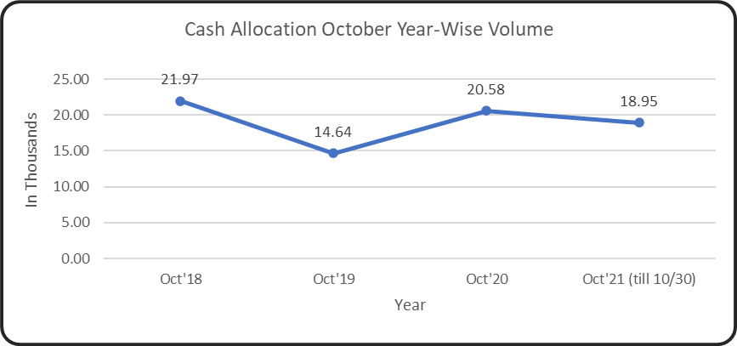
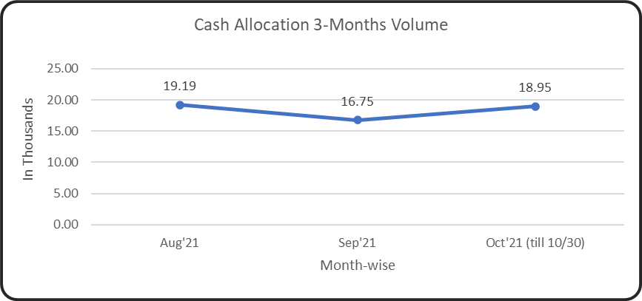
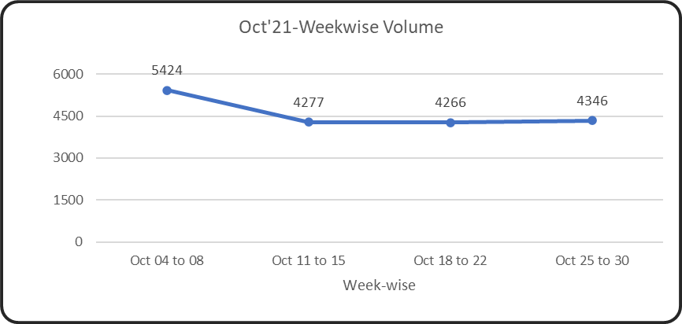

Aetna–Cash Allocation – Volume Trend Analysis:
Note :
Volumes are fluctuated in the month of Oct’21 and till now we have reached 70% of Oct’20 volumes till 3rd week of Oct’21.
8
// © 2020 Sutherland Global Services, Inc. All Rights Reserved.

Slide 9
Aetna – KPI Tracker Cash Allocation from Oct 25 to Oct 29, 2021 (P1)
9
// © 2020 Sutherland Global Services, Inc. All Rights Reserved.

Slide 10
Aetna – KPI Tracker Cash Allocation from Oct 25 to Oct 29, 2021 (P2)
10
// © 2020 Sutherland Global Services, Inc. All Rights Reserved.

Slide 11
Aetna – UNID payments Jan’20 – Oct’21 till 11/01/21:
Major Contribution:
$1.4K – Customer “Workplace Options LLC” check belongs to "Q2 2021 Broker Commissions“. We sent email to Kelli for assistance. She advised to place in UNID log, and she said that the payment will be included on the weekly email that is sent to AGB team for review.

Slide 12
Aetna Insurance – Attendance Oct-2021
Notes:
Team Shrinkage is 7.59% from period Oct 01 to Oct 22, 2021.
Anand was on Sick leave. (Oct 01 & 13).
Muthukumar was on Sick leave due (Oct 04 & 22).
Ramkumar had a system issue. (Oct 06).
Rishika was on PL (Oct 08).
Jayanthi was on PL (Oct 11, 12, & 13) and SL on (Oct 18 & 19).
Gurhu was on SL (Oct 22).
Swathy S was on PL (Oct 14 & 15).
Nadhiya was on PL (Oct 12).
Saravanan was on EMPL (Oct 13).
12
// © 2020 Sutherland Global Services, Inc. All Rights Reserved.

Slide 13
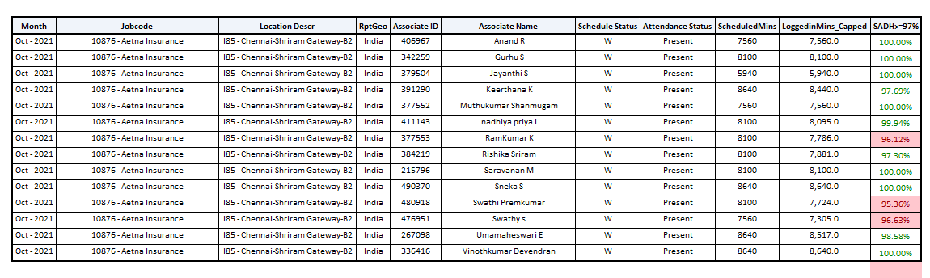
Aetna SADH – Update: Oct-2021
Notes:
Ramkumar – He had a system issue on 10/06/2021 and brought her system back to office for repair.
Rishika S – She took permission on 10/07/2021.
Swathi S – She took permission on 10/05/2021 due to unwell.
Swathi P, Keerthana & Uma – They had a system issue on 10/18/2021 due to new system replacement.
Team % ---- 98.67%
13
// © 2020 Sutherland Global Services, Inc. All Rights Reserved.

Slide 14

Team Performance Overview
Oct 25, 2021
14
// © 2020 Sutherland Global Services, Inc. All Rights Reserved.

Slide 15
Thank you
15
// © 2020 Sutherland Global Services, Inc. All Rights Reserved.
Notes:
Thank you!!

