Slide 1

Team Performance Overview
July 05, 2022
1
// © 2021 Sutherland Global Services, Inc. All Rights Reserved.

Slide 2





Automation Updates
Operational Metric’s
SLA’s & KPI’s of Cash allocation, Billing & Claims R & R are met from Jun 13 to Jun 17, 2022.
General Update:
Sasiganth was selected for Hypercare process and effective 06/22/202 he will move to that team.
Team Performance
Help Items
April’22 & May’22 invoice was pending due to new PO# & contract renewal update.
Team Prohance SADH is 99.21% from period Jun 01 to Jun 10, 2022.
Team Shrinkage is 6.25% from period Jun 01 to Jun 10, 2022.
Unable to pull the team Prohance utilization detail due to tool issue. Raised ticket and sent email to Prakash Durai for assistance.
Team AHT Utilization as per Volume received is 71% till Jun 10, 2022.
2
// © 2022 Sutherland Global Services, Inc. All Rights Reserved.

Slide 3
Aetna – SLA / KPI’s :
Note :
Billing : We have received volume in 7 KPI’s & 1 SLA out of 9 Deliverables.
Cash Allocation : We have received volume in 27 KPI’s & 1 SLA out of 31 Deliverables.
Claims R & R : We have received volume in 16 KPI’s & 1 SLA out of 18 Deliverables.
3
// © 2022 Sutherland Global Services, Inc. All Rights Reserved.

Slide 4
Aetna – Claims R & R – Volume Trend Analysis:
Note :
We have received almost similar volume on all three months (Apr, May & Jun’22).
4
// © 2022 Sutherland Global Services, Inc. All Rights Reserved.

Slide 5
Aetna – KPI Tracker Claims from Jun 27 to Jul 01, 2022 :
5
// © 2022 Sutherland Global Services, Inc. All Rights Reserved.

Slide 6
Aetna –SFB Billing – Volume Trend Analysis:
Note :
We have received 29% low volume in the month of May’’22 when we compare with Apr’22 & Jun’22.
6
// © 2022 Sutherland Global Services, Inc. All Rights Reserved.

Slide 7
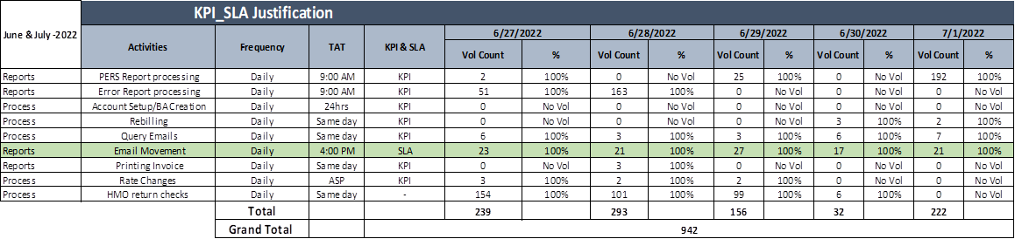
Aetna – KPI Tracker Billing from Jun 27 to Jul 01, 2022 :
7
// © 2022 Sutherland Global Services, Inc. All Rights Reserved.

Slide 8

Aetna–Cash Allocation – Volume Trend Analysis:
Note :
We have received 8% low volume in the month of May’22 & June’22 when we compare with Apr’22. Volume fluctuating on weekly volume trend.
8
// © 2022 Sutherland Global Services, Inc. All Rights Reserved.

Slide 9

Unclaimed Property – Volume Trend:
Note: Volume Count till Ju1 01, 2022
9
© 2022 Sutherland Global Services, Inc. All Rights Reserved.

Slide 10
AP Invoice Intake Process – Monthly Volume Trend Analysis
Note: Volume count till Jul 01, 2022.
10
© 2022 Sutherland Global Services, Inc. All Rights Reserved.

Slide 11
Kofax Document Review– Monthly Volume:
Note: Volume count till Ju1 01, 2022.
11
© 2022 Sutherland Global Services, Inc. All Rights Reserved.

Slide 12
Aetna – KPI Tracker Cash Allocation from Jun 27 to Jul 01, 2022 (P1)
12
// © 2022 Sutherland Global Services, Inc. All Rights Reserved.

Slide 13
Aetna – KPI Tracker Cash Allocation from Jun 27 to Jul 01, 2022 (P2)
13
// © 202 Sutherland Global Services, Inc. All Rights Reserved.

Slide 14

General Ledger Recon Training Updates :
Note:
Total Volume received for June’22 is 74 recons. GL team completed 73 recons and 1 recons are pending.
We have completed all the volumes received in Phase 1 & 2 (Totally 75 Recons)

Slide 15
Aetna – UNID payments Jul’22 till 07/05/22:
Major Contribution:
$32K received in BOA Wires, and we are unable to locate this wire and we sent an email to Kelli for further assistance.
$20K + $22K received in Bank one Wires, and we are unable to locate this wire and we sent an email to Kelli for further assistance.
$6K belongs to Forex Credit received in Scotia Bank wire, Kelli is working on it.
// © 2022 Sutherland Global Services, Inc. All Rights Reserved.

Slide 16
Aetna Insurance – Attendance June 2022 (till 06/10/2022)
Notes:
Team Shrinkage is 6.25% from period Jun 01 to Jun 10, 2022.
Sneka was on Marriage leave (06/07 to 06/10)
Rishika was on PL (06/09 & 06/10)
Anand was on PL (06/06)
Balaji was on SL (06/08)
16
// © 2022 Sutherland Global Services, Inc. All Rights Reserved.

Slide 17
Aetna Prohance SADH – Update: June 2022 (till 06/10/2022)
Notes:
Team % ---- 99.21%
Rishika had a permission on 06/09.
17
// © 2022 Sutherland Global Services, Inc. All Rights Reserved.

Slide 18
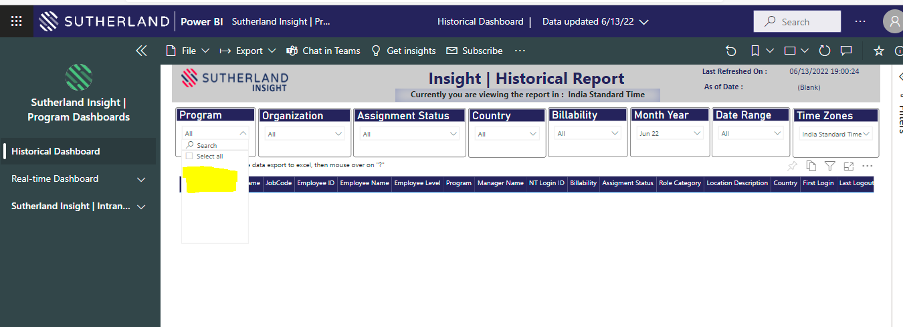
Aetna Prohance & AHT Utilization – Update: June 2022 (till 06/10/2022)
Notes:
Unable to pull the team Prohance utilization detail due to tool issue. Raised ticket and sent email to Prakash Durai for assistance.
Team AHT Utilization as per Volume received is 71% till June 10, 2022.
18
// © 2022 Sutherland Global Services, Inc. All Rights Reserved.

Slide 19

Team Performance Overview
June 13, 2022
19
// © 2022 Sutherland Global Services, Inc. All Rights Reserved.

Slide 20
Thank you
20
// © 2021 Sutherland Global Services, Inc. All Rights Reserved.
Notes:
Thank you!!

