Slide 1

Virtual Employee Connect Forum
Call Date – Feb 17, 2022
1
// © 2021 Sutherland Global Services, Inc. All Rights Reserved.

Slide 2


Slide 3
Team Updates

Slide 4





Automation Updates :
Operational Metric’s :
Cash Allocation :
NA
SLA’s and KPI’s have met in all the three LOB’s.
Process Update:
Team have successfully completed the December’21 & January’22 month-end closure for all three LOB’s.
Jan’22 - We have successfully completed the Claims new activities training and went live on 4 activities and dropped one activity due to CEQ access constrain.
Team have started to take AP & O2C training course in SGS excellence portal.
Team Performance
Help Items / Training :
January’ 22:
Team SADH is 98.94% from period Oct 01 to Oct 31, 2021.
Team Shrinkage is 5.44% from period Oct 01 to Oct 31, 2021.
None
4
// © 2021 Sutherland Global Services, Inc. All Rights Reserved.

Slide 5
Aetna - SLA & KPI’s
Note :
Billing : We met 6 KPI’s & 1 SLA out of 7 Deliverables.
Cash Allocation : We met 28 KPI’s & 1 SLA out of 31 Deliverables.
Claims R & R : We met 17 KPI’s & 1 SLA out of 18 Deliverables.
5
// © 2021 Sutherland Global Services, Inc. All Rights Reserved.

Slide 6
Claims R & R – Volume Trend Analysis
Claims R & R - Process updates:
We have successfully Go-live in 4 new activities in January’2022.
On last Governance call, team got an appreciation from Jeff regarding to took over the new activities shortly without any callouts.
Jeff confirmed that, Quick base volume will be reducing on upcoming months.
Week wise volume trend:
We have fluctuation in week-wise volume due to QuickBase request.
4 months volume comparison volume trend
Compared to Nov’21, Dec’21 & Jan’22 Volumes, we have around 34% volume increase in Oct’21. Due to add-on project from Jeff.
6
// © 2021 Sutherland Global Services, Inc. All Rights Reserved.

Slide 7
SFB Billing – Volume Trend Analysis:
In Thousands
SFB Billing – Process updates:
We have successfully completed 2021 Year-end volumes without any callouts.
KEY SFB Billing customers are migrating into EBS billing tool. Hence, we will see a volume reduction on upcoming months on this year 2022.
Week wise volume trend
We have fluctuation in week-wise volume and received more volume in 1st Week in PEERS and ERROR report activity.
4 months volume comparison volume trend
When we compare with Oct & Nov’21 volumes, we have around 53% volume increase in Dec’21 & Jan’22.
7
// © 2021 Sutherland Global Services, Inc. All Rights Reserved.

Slide 8
Cash Allocation – Volume Trend Analysis:
Cash Allocation -- Process updates:
Dec’21 & Jan’22 - We have been receiving bulk volume in IWT transfers activity due to HMO Oracle was migrating to Market Prominence tool.
Due to KEY SFB billing migration, we will see volume reduction in Checks & wires activity on upcoming months.
Week wise volume trend
We have fluctuation in week-wise volume and received 25% of high volume in last week of the Jan’22 and on avg we have received around 7,300 per week.
4 months volume comparison volume trend
When we compare the Oct & Nov’21 Volumes, we have around 76% volume increase on Dec’21. Due to bulk volume received in IWT transfers activity.
8
// © 2021 Sutherland Global Services, Inc. All Rights Reserved.

Slide 9
Unclaimed Property Volume Trend:
AP Volume Trend:
9
// © 2021 Sutherland Global Services, Inc. All Rights Reserved.

Slide 10
Team ProHance Efficiency Trend June’20
Aetna Shrinkage & Attendance Details – October’2021
Notes:
Team Shrinkage is 5.44% from period Oct 01 to Oct 31, 2021.
Anand was on SL (Oct 01 & 13).
Gurhu S was on SL (Oct 22 & 25).
Jayanthi was on PL (Oct 11 to 13) & SL (Oct 18 & 19).
Muthu was on SL (Oct 4 & 22).
Nadhiya was on PL (Oct 12).
Ramkumar had a system issue (Oct 06).
Rishika was on PL (Oct 08).
Saravanan was on EMPL.
Swathi Premkumar was on PL (Oct 11).
Swathy was on PL (Oct 14 & 15).
10
// © 2021 Sutherland Global Services, Inc. All Rights Reserved.

Slide 11
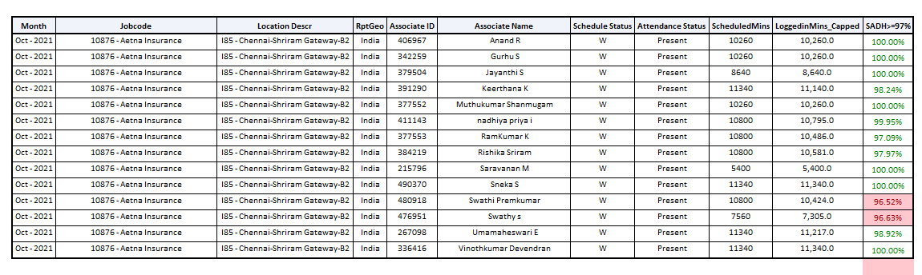
Team SADH – October’2021
Notes:
Swathi S – She took permission on 10/05/2021 due to unwell.
Swathi P, Keerthana & Uma – They had a system issue on 10/18/2021 due to new system replacement.
Ramkumar – He had a system issue on 10/06/2021 and brought her system back to office for repair.
Rishika S – She took permission on 10/07/2021.
Team % ---- 98.94%
11
// © 2021 Sutherland Global Services, Inc. All Rights Reserved.

Slide 12
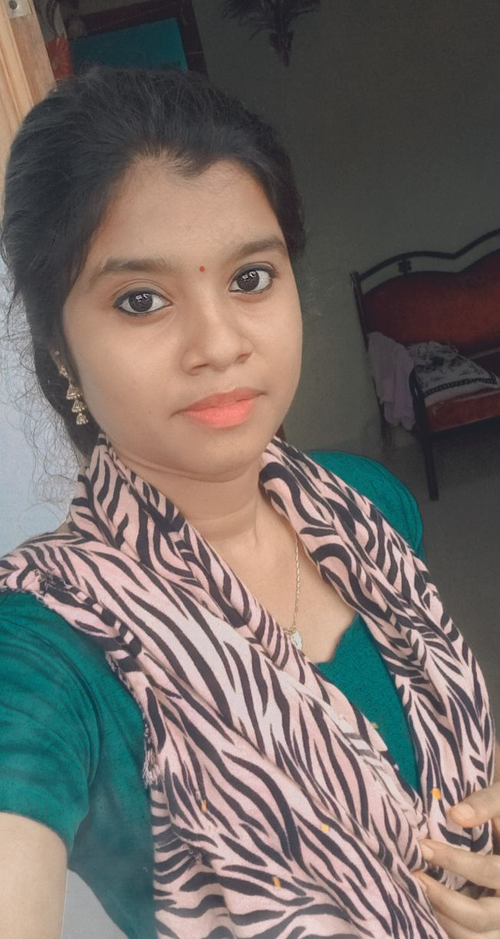

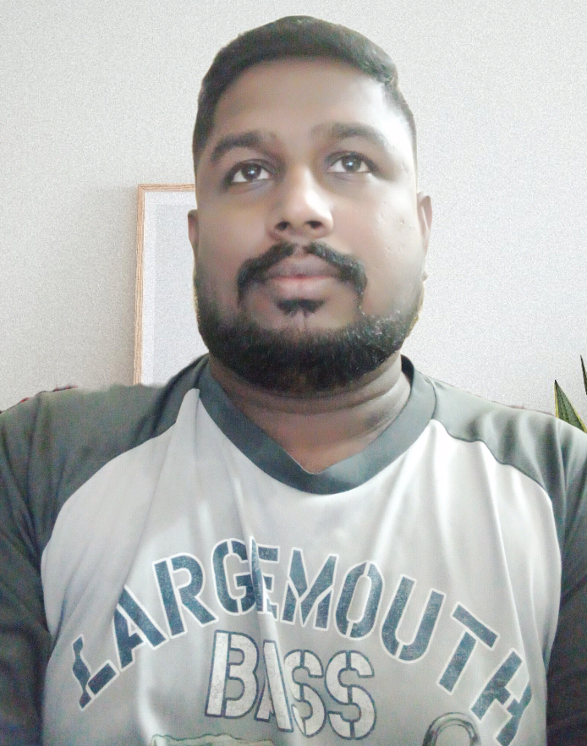
October’2021 Birthday Celebrities
11-Oct
13-Oct
12
// © 2021 Sutherland Global Services, Inc. All Rights Reserved.

Slide 13
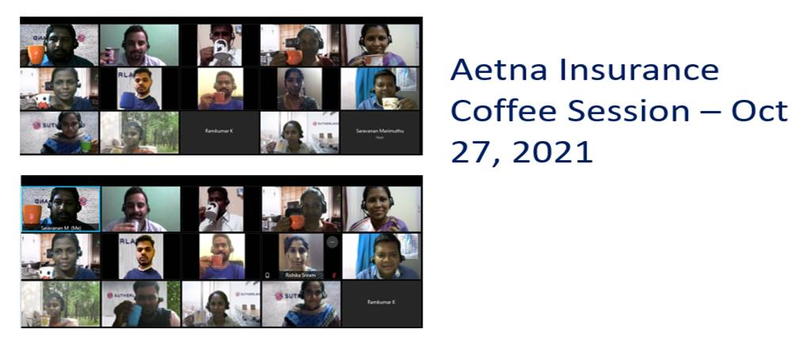
Coffee Session with Team – 10/27/2021
13
// © 2021 Sutherland Global Services, Inc. All Rights Reserved.

Slide 14
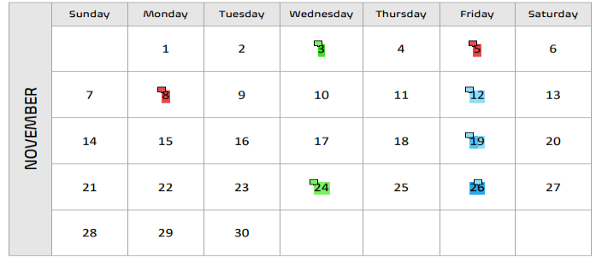
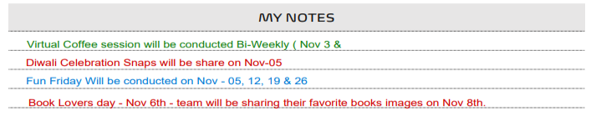
November’2021 HRC Calendar – Aetna Insurance
14
// © 2021 Sutherland Global Services, Inc. All Rights Reserved.

Slide 15
Thank you

